Slide 1
T language
411121307 葉宸君

Slide 2
Problem description
Use lex (or flex) and yacc (or bison) to implement a front end (including a lexical analyzer and a syntax recognizer) of the compiler for the T language, showing the grammar rules applied while parsing.
In the front-end we have two components:
Lexical analyzer (t_lex.l) use to separate the input.
Syntax analyser (t_parse.y) use to check if the input is grammar legal.

Slide 3
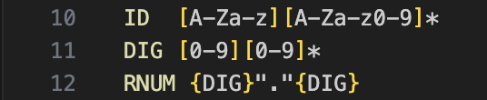
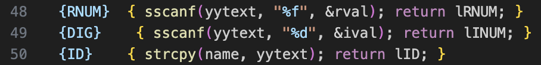
Problem fix (1) t_lex.l
We define “ID”, “DIG”, “RNUM” in definitions area, and didn’t define the rules.
Add return in rules area respectively.

Slide 4
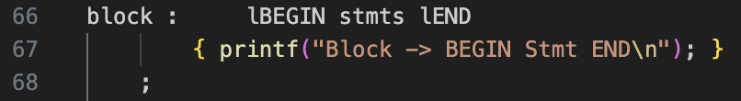
Problem fix (2) t_parse.y
The symbol ”block” is used in “mthdcl”, but didn’t define the rules.
What “block” looks like in program?
We use block in rules like:
BEGIN
stmts…
END
So we define block as:

Slide 5
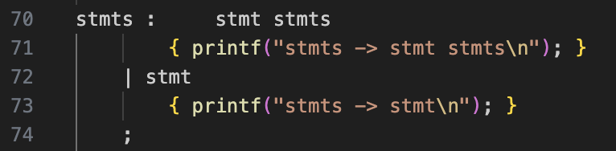
Problem fix (2) t_parse.y cont.
Now define “stms”:
“stmts” can be combined by many “stmt”.
To handle this condition, we use left recursion to define “stmts”.

Slide 6
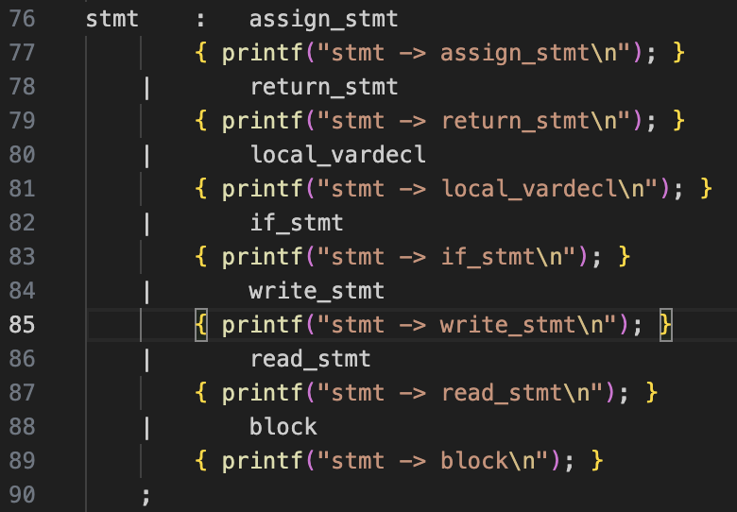
Problem fix (2) t_parse.y cont.
Define “stmt”:
We have these function in our test cases:
assign_stmt: assignment statement
return_stmt: return statement
local_vardecl: local variable declaration
if_stmt: if statement
wirte_stmt: write statement
read_stmt: read statement
List all the statements in “stmt”

Slide 7
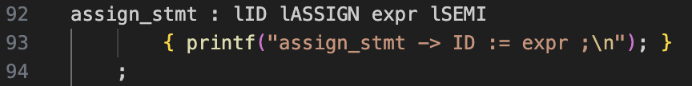
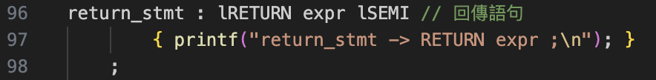
Define stmt
“assign_stmt” stands for assignment statement:
x := expr;
“return_stmt” stands for return statement:
RETURN expr;

Slide 8
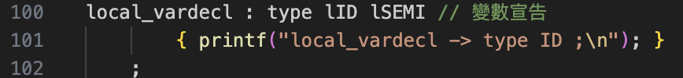
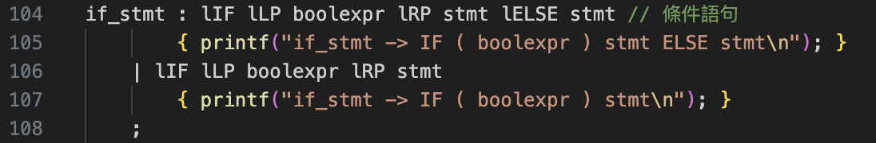
Define stmt cont.
“local_vardecl” stands for local variable declaration:
INT x; REAL y;
“if_stmt” stands for if statements:
IF (...) ... ELSE ...

Slide 9
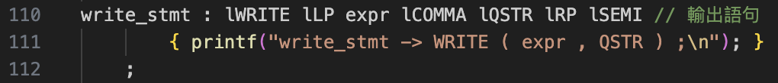
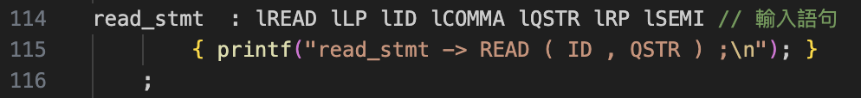
Define stmt cont.
“write_stmt” stands for write statement:
WRITE(expr, "msg");
“read_stmt” stands for read statement:
READ(x, "msg");

Slide 10
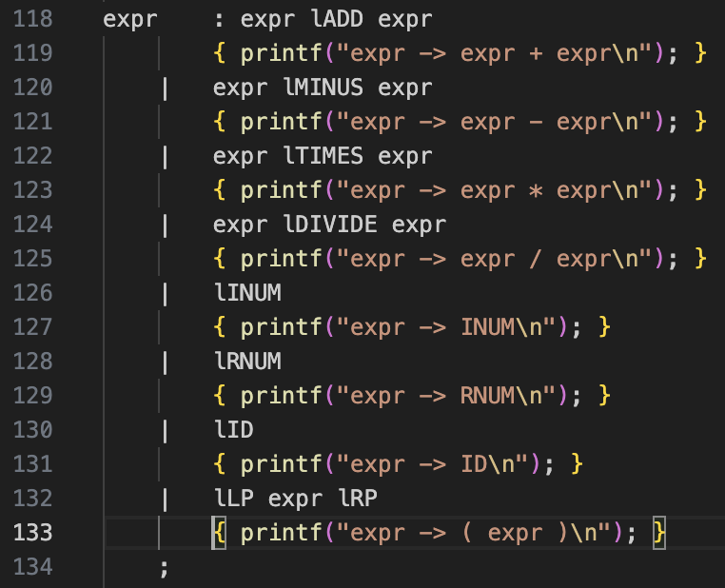
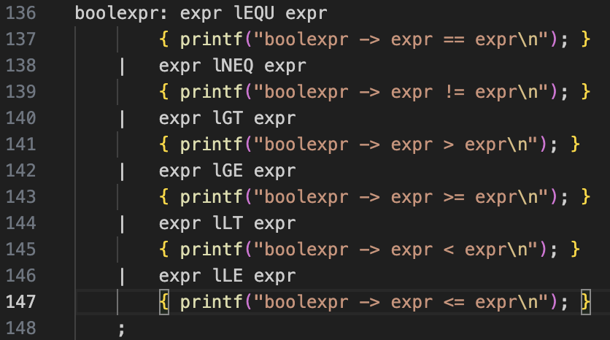
Define expr
“expr” and “bool_expr” are used in previous declaration, define them here:

Slide 11
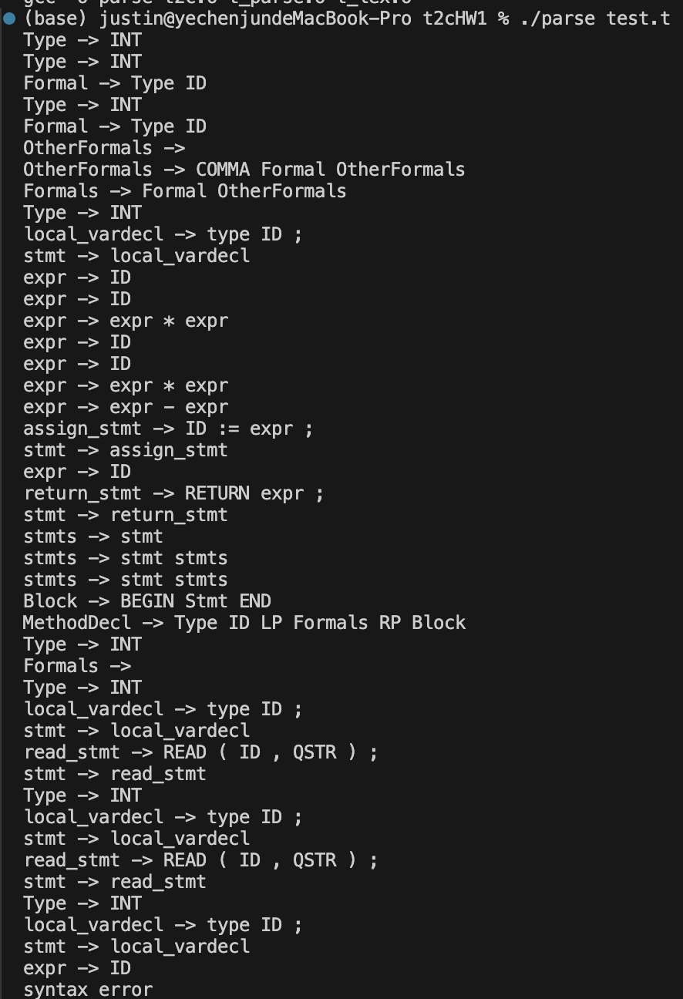
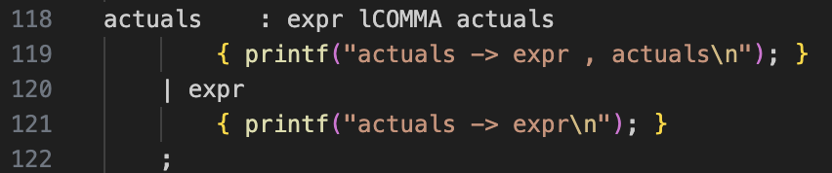
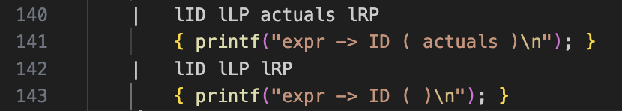
test.t first attempt / fixed
Syntax error due to the line in test.t: z := f2(x,y) + f2(y,x);
Didn’t define “function call” in t_parse.y
Add “actuals”, “lID lLP actuals lRP” and “lID lLP lRP” in “expr”

Slide 12
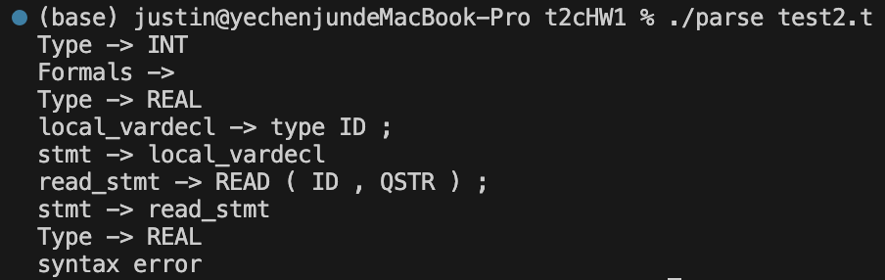
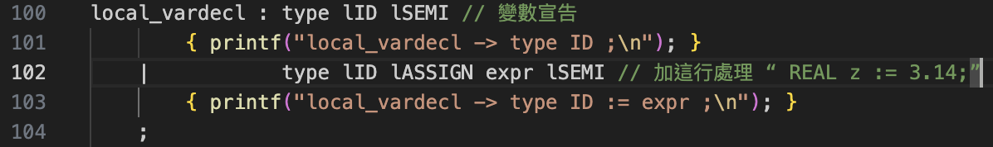
test2.t first attempt / fixed
Syntax error due to the line in test2.t:
REAL z := 3.14;
Didn’t define value initialize in “local_vardecl”
Add another condition in “local_vardecl”

Slide 13
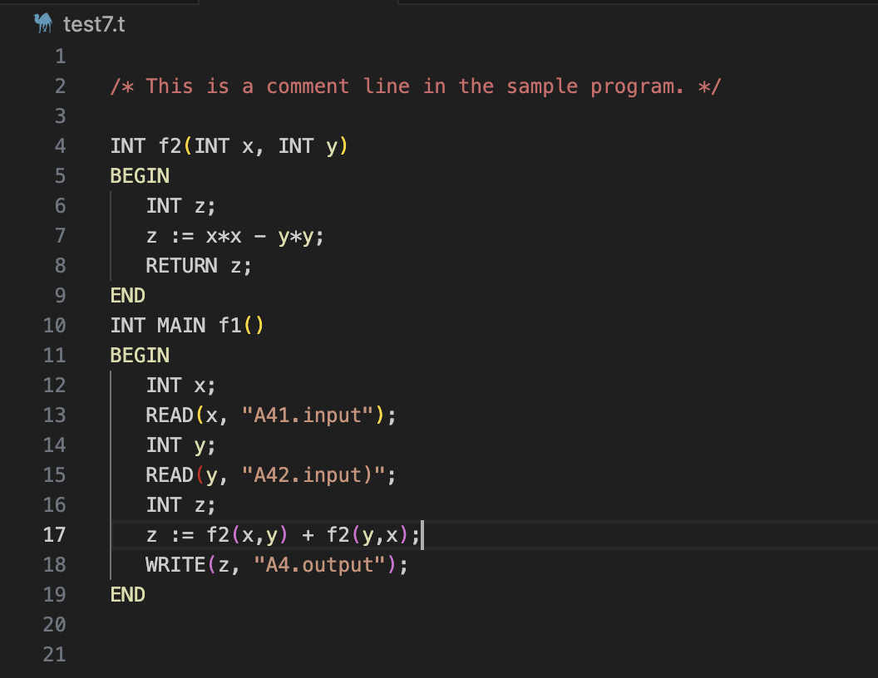
test7.t first attempt / fixed
Syntax error due to the illegal grammar in test7.t in the package:
Line 15 should be:
READ(y, "A42.input");
READ(y, "A42.input)";

Slide 14
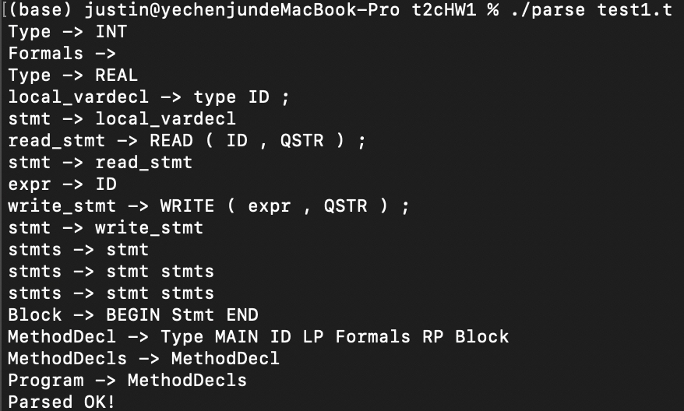
test1.t results

Slide 15
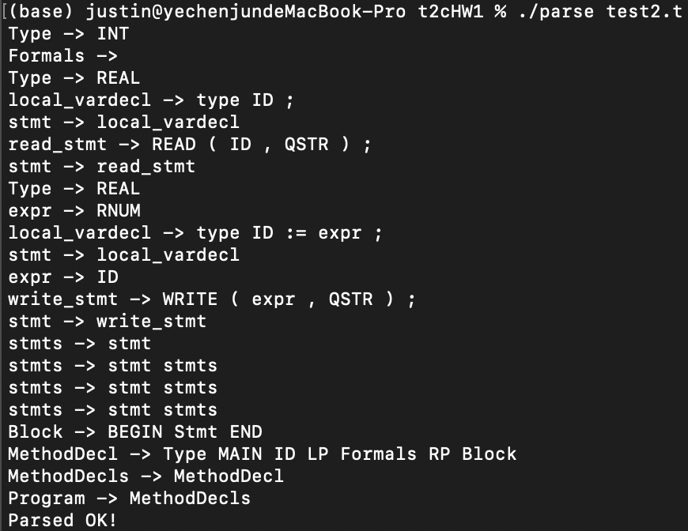
test2.t result

Slide 16
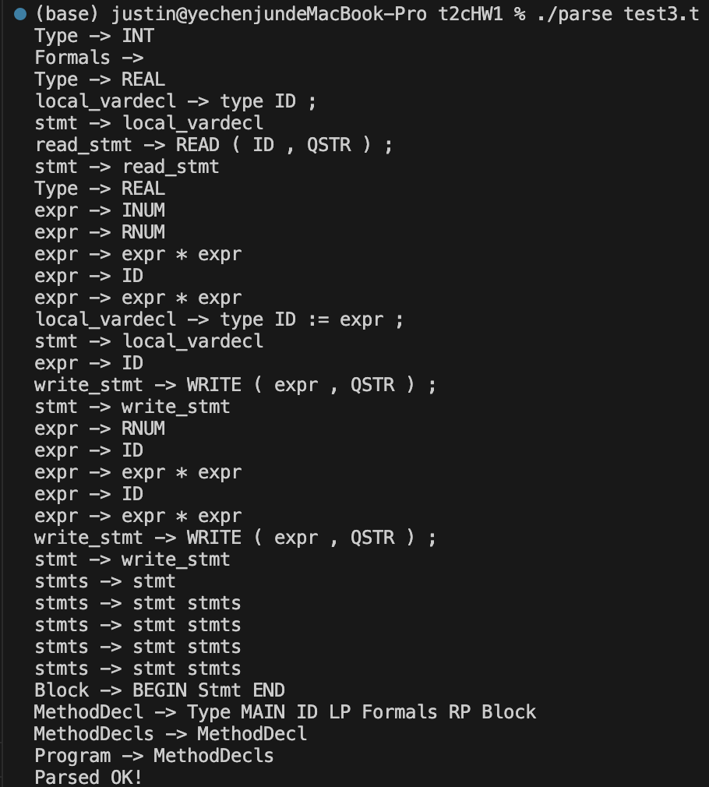
test3.t result

Slide 17
Discussion
We finished t_lex.l by adding the “RNUM”, “DIG”, “ID” in rules area, then we define legal grammar for T grammar in t_parse.y .
Some grammar is lost while running the test.t file, so we { printf("****** Parsing failed!\n"); } and syntax error in t_parse.y to check if the program is legal or not.
Finally, gcc combine “t2c.o”, “t_lex.o” and “t_parse.o” into “parse”.
And we run ./parse test.t to execute the program in T language.

Slide 18
File struct
Bison: grammar analyzed
Lex: tokens analyzed
file | character | description
t_parse.y | Original Yacc grammar file | The grammar we defined
t_parse.c | C code generated by Bison | Auto generated by bison -d t_parse.y
t_parse.h | Tokens generated by Bison | Define all the “%token” correspond to integer
file | character | description
t_lex.l | Original Lex file | The tokens we defined, return to parser
t_lex.c | C code generated by Lex | Auto generated by flex -o t_lex.c t_lex.l

Slide 19
Discussion cont.
Main code
Compile result and executable files
file | character | description
t2c.c | Assist code | The tokens we defined, return to parser
t2c.h | Header file | Used by lex and yacc
t_lexMain.c | Main program entrance | Call yyparse() and print Parsed OK!
file | character | description
t_lex.o | Header file | Generated while compile t_lex.c
t_parse.o | Header file | Generated while compile t_parse.c
t2c.o | Header file | Generated while compile t2c.c
parse | Executable file | Final program

